Slide 1
FOSTERING SENSE OF BELONGING
Activity created by Aparajita Jaiswal, Aletha Stahl, and Kelsey Patton, CILMAR.

Slide 2
Objectives
As a result of this activity, participants will be able to:
Understand the role of interaction and communication in fostering a sense of belonging.
Appreciate the differences and identify the commonalities among people from different cultures or backgrounds.

Slide 3
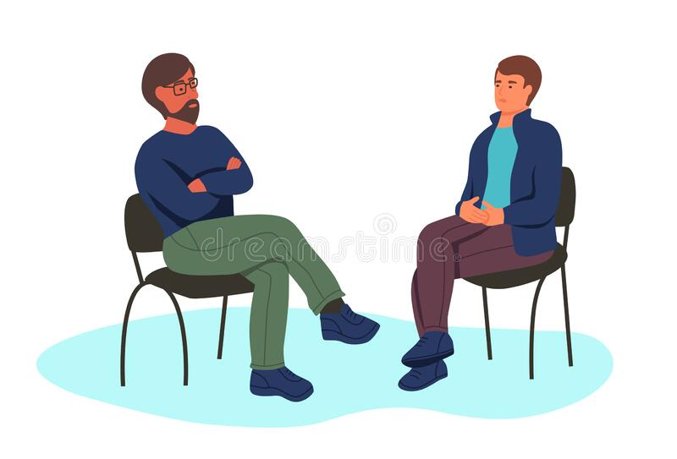
Decide which topic you would like to discuss between the topic cards you and your partner have. Talk about the chosen topic for two minutes.
After your conversation, switch cards with your partner and repeat the above instruction with a new partner.

Slide 4
Debriefing questions
How did this activity make you feel? What surprised you about this activity?
What connections did you make with others?
How would you define sense of belonging? What creates sense of belonging for you? How did this activity inform your understanding of sense of belonging?

Slide 5
Debriefing questions (10 mins)
What was the role of commonalities and differences in your connection with partners?
What aspects of this activity might you bring into your personal/academic/professional life?

Slide 6
Sense of Belonging
Sense of belonging is referred to as the extent to which a member feels accepted within a community (O’Keeffe, 2013).
This acceptance only has the potential to be felt when members of a community interact and communicate in healthy and meaningful ways with one another.
In this activity, participants will learn how positive interaction with a member from another culture can improve overall sense of belonging.

Slide 7
Thank you!

Slide 8
References
O'Keeffe, P. (2013). A sense of belonging: Improving student retention. College Student Journal, 47(4), 605-613.

